Slide 1

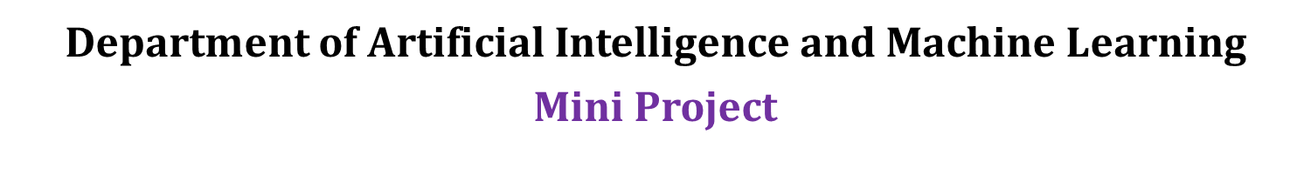
Project Title : This Agriculture crop price prediction
Guided By:
Sri. M. Vishnu Chaitanya
Assistant Professor
Presented By:
1601-22-748-025 :G. Rami Reddy
1601-22-748-030 : K.Abhiram Chandra
1601-22-748-301 : B.Rajesh

Slide 2
Abstract
This Agriculture crop price prediction model is a machine learning model based on historical data and various influencing factors to predict crop prices. This model aims to improve the accuracy of price forecast, thereby contributing to better planning and risk management in the sector of agriculture. This project helps farmers, traders and policy makers in making decisions regarding crop yield and distribution. By considering various aspects like crop area, Crop production, GDP, Annual Gross Rate, Inflation, Rainfall, price of the crop in the previous years and Temperature this model predicts the price of the crop per yield based on the above mentioned parameters . Our project aims to improve the accuracy in predicting the price of the crop based on the following parameters. However, in recent years, the emergence of machine learning techniques has offered promising solutions to enhance crop price prediction. This project conducts an extensive review of various machine learning approaches utilized for this purpose, forecasting techniques, ensemble methods, and deep learning strategies. We delve into the unique strengths, limitations, and practical applications of each technique. Moreover, we address the prevalent challenges associated with employing machine learning in crop price prediction, such as data accessibility, feature selection, model interpretability, scalability, and generalization. Additionally, we look ahead to future research avenues and opportunities aimed at refining the accuracy and utility of machine learning models in predicting crop prices.

Slide 3
Base Paper
1. Singh, N., & Sindhu, R. (2024). Crop Price Prediction Using Machine Learning. Journal of Electrical Systems, 20(7s), 2258-2269.
Objective
Ensemble Techniques and Hybrid Models: Investigating ensemble techniques, such as stacking, bagging, and boosting, could improve the robustness and generalization performance of crop price prediction models. Hybrid models that combine multiple machine learning algorithms, including deep learning architectures, reinforcement learning, and Bayesian approaches, may offer synergistic benefits and capture a broader range of patterns and dependencies in crop price data. • Dynamic Model Adaptation: Developing adaptive machine learning models capable of continuously updating and refining predictions in response to changing market conditions, weather patterns, and socioeconomic factors could enhance the timeliness and accuracy of crop price forecasts. Techniques such as online learning, transfer learning, and model ensembling with rolling windows could facilitate dynamic model adaptation in real-time scenarios. • Interpretability and Explainability: Enhancing the interpretability and explainability of machine learning models is essential for fostering trust and understanding among end-users, including farmers, traders, and policymakers. Research into model-agnostic interpretability methods, feature importance analysis, and posthoc explanations could provide valuable insights into the underlying drivers of crop price movements and facilitate informed decision-making. • Integration with Decision Support Systems: Integrating machine learning-based crop price prediction models into decision support systems and agricultural management platforms could empower stakeholders with actionable insights and recommendations. Customized dashboards, alerts, and risk management tools tailored to specific user needs and preferences could facilitate proactive decision-making and risk mitigation strategies. • Ethical and Societal Implications: Investigating the ethical, societal, and environmental implications of machine learning-driven crop price prediction is essential for ensuring equitable and sustainable agricultural practices. Research into fairness, bias mitigation, privacy preservation, and responsible AI governance frameworks can help mitigate potential risks and promote equitable access to predictive analytics tools.

Slide 4
Introduction
The agricultural industry is fundamental to global economies, providing sustenance, resources, and livelihoods for billions of individuals. At the heart of thisindustry liesthe crucial aspect of crop pricing, influencing the earnings of farmers, the choices of policymakers, and the purchasing power of consumers. Nonetheless, accurately forecasting crop prices proves to be a daunting task, primarily due to the intricate and unpredictable nature of agricultural markets. Conventional approaches to predicting crop prices heavily lean on historical patterns and the insights of experts, yet frequently falter in delivering accurate and timely forecasts. The ever-changing landscape of agricultural markets, influenced by factors like weather patterns, demand shifts, geopolitical tensions, and supply chain disruptions, challenges the effectiveness of traditional methodologies in grasping the subtleties of price variations. In recent years, the advent of machine learning techniques has revolutionized the landscape of crop price prediction. Machine learning, a subset of artificial intelligence, empowers computers to learn from data patterns and make predictions or decisions without explicit programming. Leveraging vast dataset encompassing diverse variables, machine learning algorithms can discern intricate relationships and uncover hidden patterns within agricultural market data. Algorithms can discern intricate relationships and uncover hidden patterns within agricultural market data. This scholarly article undertakes an extensive investigation into the utilization of machine learning for forecasting crop prices. It delves into a range of machine learning techniques such as regression models, time series forecasting, ensemble methods, deep learning structures, and hybrid approaches.

Slide 5
Problem Statement
Develop a machine learning model to predict the crop price in a particular region. Based upon various factors such as crop area, Crop production, GDP, Annual Gross Rate, Inflation, Rainfall, price of the crop in the previous years and Temperature. Considering all the aspects we try to predict the price of the crop in the market and be a helping hand to various users such as farmers, traders and policy makers in making decisions regarding crop yield and distribution.
Incorporating machine learning techniques like ensemble methods, forecasting and deep learning will enhance predictive accuracy by leveraging complex patterns in large datasets. We plan to use historical weather patterns and climate change projections to model potential future scenarios, offering more robust predictions under varying climatic conditions. By extending our analysis to include these additional variables and advanced techniques, we aim to provide a comprehensive and dynamic tool that not only predicts crop prices but also offers actionable insights for optimizing agricultural practices and policy decisions.

Slide 6
Objective of the Work
1. Develop a Predictive Model: Build a machine learning model that accurately predict the price of the crop, by using factors like crop area, Crop production, GDP, Annual Gross Rate, Inflation, Rainfall, price of the crop in the previous years and Temperature.
2. Analyse crop price: Evaluate the impact of various features such as crop area, Crop production, GDP, Annual Gross Rate, Inflation, Rainfall, price of the crop in the previous years and Temperature to give the price of the crop.

Slide 7
Literature survey
Reference 1
Singh, N., & Sindhu, R. (2024). Crop Price Prediction Using Machine Learning. Journal of Electrical Systems, 20(7s), 2258-2269.
Crop price prediction is a pivotal aspect of agricultural economics, impacting stakeholders across the industry, from farmers to policymakers to consumers. Traditional methodologies often struggle to provide accurate and efficient predictions, primarily due to the intricate and ever-changing nature of agricultural markets. However, in recent years, the emergence of machine learning techniques has offered promising solutions to enhance crop price prediction. This paper conducts an extensive review of various machine learning approaches utilized for this purpose, covering regression-based methods, time series forecasting techniques, ensemble methods, deep learning strategies, and hybrid models. We delve into the unique strengths, limitations, and practical applications of each technique. Moreover, we address the prevalent challenges associated with employing machine learning in crop price prediction, such as data accessibility, feature selection, model interpretability, scalability, and generalization. Additionally, we look ahead to future research avenues and opportunities aimed at refining the accuracy and utility of machine learning models in predicting crop prices. Through this comprehensive review, we aim to provide valuable insights for researchers, practitioners, and policymakers, facilitating informed decision-making in agricultural contexts through the utilization of machine learning methodologies.

Slide 8
Literature survey
Reference 2
Dharmayanti, D. I. A. N., Akma, A. O., Soegoto, E. S., & Warlina, L. (2024). APPLICATION OF DATA MINING FOR PREDICTING HORTICULTURAL COMMODITIES PRICE. Journal of Engineering Science and Technology, 19(1), 163-175
In Garut Regency, farmers receive their commodities at a selling price that collectors determined. This issue causes farmers to lose money because their income does not correspond with the market price for their goods. This loss has an impact on reducing farmer productivity. Therefore, this research aims to provide recommendations to farmers regarding commodity selling prices for particular periods based on forecast results. This research implements data mining so commodities selling prices can be predicted. Data mining is a way to find patterns or knowledge from past data. Multiple linear regression methods or algorithms are used to find patterns or knowledge with data mining. Multiple linear regression can be used to predict commodities selling prices based on rainfall factors and total production. The application developed can produce recommendations for farmers for commodity selling prices for specific periods based on prediction results, thereby reducing losses for farmers

Slide 9
Literature survey
Reference 3
Mohanty, M. K., Thakurta, P. K. G., & Kar, S. (2023). Agricultural commodity price prediction model: a machine learning framework. Neural Computing and Applications, 35(20), 15109-15128.
An efficient machine learning-based framework for crop price prediction is proposed in this paper to assist the farmers in estimating their profit-loss beforehand. The proposed work is composed of four functional blocks, such as crop yield prediction, determination of supply, demand prediction and crop price prediction. The input datasets consist of the various field values, such as yield, remaining crop at the end of the year, import, demand and price of a crop. Various time series-based algorithms, such as autoregression, moving average, autoregressive moving average, autoregressive integrated moving average and exponential smoothing, are used to forecast the crop yield. The supply of the crop is determined as a sum of three variables, i.e., the predicted crop yield, residue and import values. The demand for the crop is predicted from a year alone as the demand has more correlation with year over other factors. The crop price from demand, supply and year is predicted using different approaches, which include the time series method, statistical approaches and machine learning techniques. Finally, these three techniques for price prediction are compared to determine the best model having minimum root-mean-square error value. In the proposed work, the decision tree regressor is found to be the best model, for predicting crop price, over others. The superiority of the proposed work over existing approaches, in terms of various aspects, is shown by simulation results.

Slide 10
Literature survey
Reference 4
Elbasi, E., Zaki, C., Topcu, A. E., Abdelbaki, W., Zreikat, A. I., Cina, E., ... & Saker, L. (2023). Crop prediction model using machine learning algorithms. Applied Sciences, 13(16), 9288
This paper includes a discussion on the current state of machine learning in agriculture, highlighting key challenges and opportunities, and presents experimental results that demonstrate the impact of changing labels on the accuracy of data analysis algorithms. The findings recommend that by analyzing wide-ranging data collected from farms, incorporating online IoT sensor data that were obtained in a real-time manner, farmers can make more informed verdicts about factors that affect crop growth. Eventually, integrating these technologies can transform modern agriculture by increasing crop yields while minimizing waste. Fifteen different algorithms have been considered to evaluate the most appropriate algorithms to use in agriculture, and a new feature combination scheme-enhanced algorithm is presented. The results show that we can achieve a classification accuracy of 99.59% using the Bayes Net algorithm and 99.46% using Naïve Bayes Classifier and Hoeffding Tree algorithms. These results will indicate an increase in production rates and reduce the effective cost for the farms, leading to more resilient infrastructure and sustainable environments. Moreover, the findings we obtained in this study can also help future farmers detect diseases early, increase crop production efficiency, and reduce prices when the world is experiencing food shortages.

Slide 11
Literature survey
Reference 5
Hirapara, J., & Vanjara, P. (2022, April). A comparative study of data mining techniques for agriculture crop price prediction. In 2022 IEEE 7th International conference for Convergence in Technology (I2CT) (pp. 1-6). IEEE
In India agriculture production, when it is calculated per farmer, it is very instable is there compare to rest of the world, when compared to individual farmer in various countries with stable environment, and without providing sufficient MSP it will not benefit farmers and agriculture fraternity. If the farmers and agriculture fraternity get an access to appropriate crop prices, then poverty can be reduced in India. In advanced agriculture development, a large quantity of data is generated from the agriculture commodity market. Agriculture has a large amount of data, however regrettably, most of this data is not extracted to find out unseen information in data— crop price forecast is more beneficial to the farmers and agriculture fraternity to take proper and timely decisions. According to the output of process, Advanced data mining techniques play a pivotal role in analysis to discover a hidden pattern in data. Performance of data mining techniques is compared with past crop prices, weather, current market prices, stock availability and the upcoming production of the crop in recent years. The data mining that is a regression analysis, Tracking Patterns, Cluster Analysis, and visualization techniques are used to create an inventive representation to predict the agricultural crop prices.

Slide 12
Literature survey
Reference 6
Soni, N., & Raut, J. (2022). Crop Price Prediction Using Machine Learning Techniques. International Advanced Research Journal in Science, Engineering and Technology (IARJSET). Published in.
Farmers play a very important role in the agriculture sector. When the prices fall after the harvesting of the crops, farmers face massive amounts of losses because this country's GDP is affected by the price fluctuations of agricultural products. Crop price evaluation and estimation are done to take an intelligent decision before farming a specific type of seasonal crops. Predicting the price of a crop will help in making better decisions which results in minimizing the losses and managing the risk of price fluctuations. In this research paper, we had predicted the price of different crops by analysing the previous rainfall and Wholesale Price Index (WPI) data. We used the Decision Tree Regressor and Random Forest, a Supervised machine learning algorithm to analyse the previous data and Time Series Analysis to estimate the crop price for upcoming twelve months.

Slide 13
Literature survey
Reference 7
Chen, Z., Goh, H. S., Sin, K. L., Lim, K., Chung, N. K. H., & Liew, X. Y. (2021). Automated agriculture commodity price prediction system with machine learning techniques. arXiv preprint arXiv:2106.12747.
The intention of this research is to study and design an automated agriculture commodity price prediction system with novel machine learning techniques. Due to the increasing large amounts historical data of agricultural commodity prices and the need of performing accurate prediction of price fluctuations, the solution has largely shifted from statistical methods to machine learning area. However, the selection of proper set from historical data for forecasting still has limited consideration. On the other hand, when implementing machine learning techniques, finding a suitable model with optimal parameters for global solution, nonlinearity and avoiding curse of dimensionality are still biggest challenges, therefore machine learning strategies study are needed. In this research, propose a web-based automated system to predict agriculture commodity price. In the two series experiments, five popular machine learning algorithms, ARIMA, SVR, Prophet, XGBoost and LSTM have been compared with large historical datasets in Malaysia and the most optimal algorithm, LSTM model with an average of 0.304 mean-square error has been selected as the prediction engine of the proposed system.

Slide 14
Literature survey
Reference 8
Ghutake, I., Verma, R., Chaudhari, R., & Amarsinh, V. (2021). An intelligent crop price prediction using suitable machine learning algorithm. In ITM web of conferences (Vol. 40, p. 03040). EDP Sciences.
Planning of crops for the next season has been a tedious task for the farmers as it is a difficult prediction about metrics of prices that their crop will fetch in a particular season which will be typically based on dynamic weather conditions. This leads to inaccurate prediction of crops’ prices by farmers, and they happen to wrongly select the crops or in haste they happen to sell their crops early without storing and thus earning less than what the same crop would have fetched them in the future. This problem could be addressed by an ML model which will predict the prices of crops in advance showing the proper analysis of the crop and presenting their future scenario so that farmers can select the right crops to strategize crop production which involves crop selection, time of sowing deciding crop pattern and storage of harvested crops providing enough insights for predicting the appropriate price in the markets.

Slide 15
Literature survey
Reference 9
Dhanapal, R., AjanRaj, A., Balavinayagapragathish, S., & Balaji, J. (2021, May). Crop price prediction using supervised machine learning algorithms. In Journal of Physics: Conference Series (Vol. 1916, No. 1, p. 012042). IOP Publishing.
When the price falls after the harvest, farmers face immense losses. A country's GDP is affected by the price fluctuations of agricultural products. Crop price estimation and evaluation are done to take an intelligent decision before farming a specific type of crop. Predicting the price of a crop will help in taking better decisions which results in minimizing the loss and managing the risk of price fluctuations. In this paper, we predicted the price of different crops by analyzing the previous rainfall and WPI data. We used the decision tree regressor (Supervised machine learning algorithm) to analyze the previous data and predict the price for the latest data and estimate the price for the twelve months to come.

Slide 16
Literature survey
Reference 10
Bayona-Oré, S., Cerna, R., & Tirado Hinojoza, E. (2021). Machine learning for price prediction for agricultural products.
Family farms play a role in economic development. Limited in terms of land, water and capital resources, family farming is essentially characterized by its use of family labour. Family farms must choose which agricultural products to produce; however, they do not have the necessary tools for optimizing their decisions. Knowing which products will have the best prices at harvest is important to farmers. At this point, machine learning technology has been used to solve classification and prediction problems, such as price prediction. This work aims to review the literature in this area related to price prediction for agricultural products and seeks to identify the research paradigms employed, the type of research used, the most commonly used algorithms and techniques for evaluation, and the agricultural products used in these predictions. The results show that the mostly commonly used research paradigm is positivism, the research is quantitative and longitudinal in nature and neural networks are the most commonly used algorithms.

Slide 17
Literature survey
Reference 11
Samuel, P., Sahithi, B., Saheli, T., Ramanika, D., & Kumar, N. A. (2020). Crop price prediction system using machine learning algorithms. Quest Journals Journal of Software Engineering and Simulation.
The paper aims to predict crop prices for the next rotation by identifying suitable data models that achieve high accuracy and generality. To address this issue, various data mining techniques were evaluated on different datasets. The work presents a system that employs data analytics techniques to predict crop prices. The proposed system applies machine learning algorithms to forecast crop prices based on multiple factors such as area harvested and area planted. This approach provides farmers with insights into future crop prices, helping them increase their profit margins over the long term. The research concludes that XGBoost is the most suitable technique for their project.

Slide 18
Literature survey
Reference 12
Medar, R., Rajpurohit, V. S., & Shweta, S. (2019, March). Crop yield prediction using machine learning techniques. In 2019 IEEE 5th international conference for convergence in technology (I2CT) (pp. 1-5). IEEE
Agriculture is the field which plays an important role in improving our countries economy. Agriculture is the one which gave birth to civilization. India is an agrarian country and its economy largely based upon crop productivity. Hence we can say that agriculture can be backbone of all business in our country. Selecting of every crop is very important in the agriculture planning. The selection of crops will depend upon the different parameters such as market price, production rate and the different government policies. Many changes are required in the agriculture field to improve changes in our Indian economy. We can improve agriculture by using machine learning techniques which are applied easily on farming sector. Along with all advances in the machines and technologies used in farming, useful and accurate information about different matters also plays a significant role in it. The concept of this paper is to implement the crop selection method so that this method helps in solving many agriculture and farmers problems. This improves our Indian economy by maximizing the yield rate of crop production.

Slide 19
Comparison Table
 | Reference (i.e. author names with reference number) | year | Objectives | Limitations | Advantages | Performance metrics | Gaps
Reference 1 | Singh, N., & Sindhu, R. | 2024 | Explore machine learning techniques for crop price prediction using electrical system datasets. | Limited to specific datasets | Use of machine learning in an emerging field | Accuracy, precision | Focus on electrical system datasets only
Reference 2 | Dharmayanti, D. I. A. N., Akma, A. O., Soegoto, E. S., & Warlina, L. | 2024 | Apply data mining techniques to predict horticultural commodities' prices | Specific to horticultural crops | Effective data mining techniques | Prediction accuracy | Limited to horticultural crops
Reference 3 | Mohanty, M. K., Thakurta, P. K. G., & Kar, S. | 2023 | Introduce a machine learning framework for predicting agricultural commodity prices | May not be generalizable | Structured framework for prediction | Accuracy, recall | Scalability
Reference 4 | Elbasi, E., Zaki, C., Topcu, A. E., Abdelbaki, W., & Zreikat, A. I. | 2023 | Develop a machine learning model for crop prediction using multiple algorithms | Algorithm selection is limited | Multiple algorithms compared | Precision, recall | Limited crop types analyzed
Reference 5 | Hirapara, J., & Vanjara, P. | 2022 | Comparative study of data mining techniques for predicting crop prices | Focuses only on data mining techniques | Comprehensive comparison | Accuracy, F1 score | Lack of real-time prediction
Reference 6 | Soni, N., & Raut, J. | 2022 | Investigate machine learning techniques for crop price prediction | Focuses on specific ML techniques | Specific to crop price prediction | Accuracy | Limited dataset
Reference 7 | Chen, Z., Goh, H. S., Sin, K. L., Lim, K., Chung, N. K. H., & Liew, X. Y. | 2021 | Present an automated agriculture commodity price prediction system | Automation focus; limited scope | Fully automated system | Precision, recall | Scalability and dataset variety
Reference 8 | Ghutake, I., Verma, R., Chaudhari, R., & Amarsinh, V. | 2021 | Use suitable ML algorithms for intelligent crop price prediction | Limited algorithm diversity | Intelligent algorithm selection | Accuracy, F1 score | Lack of algorithm diversity
Reference 9 | Dhanapal, R., AjanRaj, A., Balavinayagapragathish, S., & Balaji, J. | 2021 | Explore supervised ML algorithms for crop price prediction | Focus on supervised learning | Specific use of supervised algorithms | Precision | Excludes unsupervised learning methods
Reference 10 | Bayona-Oré, S., Cerna, R., & Tirado Hinojoza, E. | 2021 | Predict prices of agricultural products using machine learning techniques | Focused on a specific region | Efficient prediction methods | Accuracy, RMSE | Limited geographic scope
Reference 11 | Samuel, P., Sahithi, B., Saheli, T., Ramanika, D., & Kumar, N. A. | 2020 | Develop a crop price prediction system using various ML algorithms | Limited to specific algorithms | Use of multiple algorithms | Precision, recall | Lacks cross-regional data
Reference 12 | Medar, R., Rajpurohit, V. S., & Shweta, S. | 2019 | Examine ML techniques for crop yield prediction | Focused on yield rather than price | Application of multiple ML techniques | Accuracy | Does not cover price prediction

Slide 20
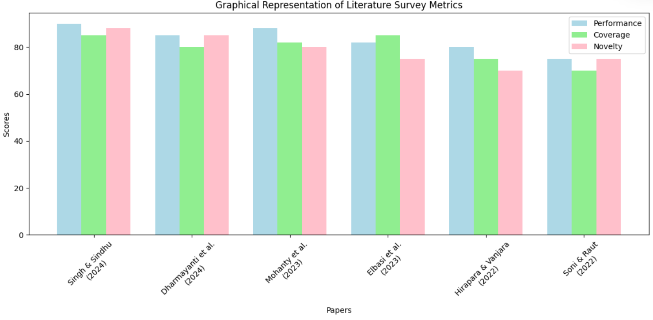

Slide 21
Methodology
1. Data Collection and Preprocessing
Data Source: The project uses a dataset with several features (e.g., Area, Production, GDP, Annual Growth Rate, Inflation, Rainfall, Temperature) to predict crop prices.
Data Preprocessing: The dataset is split into training and test sets. Missing values are handled using SimpleImputer, and numerical features are scaled to ensure all features are in a uniform range. The dataset is transformed using a pipeline that includes these preprocessing steps.
2. Feature Selection
Feature Selection: A subset of features from the dataset (e.g., Area, Production, GDP, etc.) is selected for model training. This selection is important to ensure that the model focuses on the most relevant features affecting crop prices.
3. Model Training
Random Forest Regressor: A RandomForestRegressor model is initialized and trained using the preprocessed training data (crop_num_tr) and labels (crop_labels). This ensemble method leverages multiple decision trees to improve the accuracy of the predictions and handles overfitting by averaging the results from different trees.
4. Model Evaluation
Performance on Test Set: The trained model is evaluated on a separate test dataset. The pipeline transforms the test features (X_test) to match the training data, and the model predicts crop prices. The accuracy of the predictions is evaluated using the Root Mean Squared Error (RMSE), providing a metric for how well the model generalizes to unseen data. In this case, the model achieved an RMSE of 2.317 on the test set.
5. Prediction with Custom Input
Custom Predictions: The model is tested with a custom input representing specific agricultural and economic conditions (e.g., Area, Production, GDP, Growth Rate, etc.). The input is processed through the same pipeline, and the trained model predicts a crop price based on this input. The example in the code outputs a predicted price of 968.94 for the custom input.
6. Conclusion
The methodology demonstrates the use of the Random Forest Regressor to predict crop prices based on agricultural and economic factors. It follows a structured approach of data preprocessing, model training, evaluation, and custom predictions.

Slide 22
Algorithms
1. Random Forest Regressor
Algorithm Type: Ensemble Learning (Regression)
Description: Random Forest is an ensemble learning algorithm that builds multiple decision trees during training and outputs the mean prediction of the individual trees for regression tasks. It reduces overfitting, increases prediction accuracy, and handles high-dimensional data effectively.
Usage in Project: The RandomForestRegressor was used to predict crop prices based on the selected features (e.g., Area, Production, GDP). It leverages multiple decision trees to model complex relationships between the input features and crop prices.
2. SimpleImputer (from sklearn.impute)
Algorithm Type: Missing Value Imputation
Description: The SimpleImputer is used to handle missing data by imputing missing values with a specified strategy, such as replacing them with the mean or median of the column. This ensures that the dataset does not have any missing values that would cause issues during model training.
Usage in Project: Missing values in the dataset are imputed using the mean of the respective columns. This ensures the data is complete and ready for training.
3. Feature Scaling (from sklearn.preprocessing)
Algorithm Type: Data Preprocessing (Scaling)
Description: Feature scaling ensures that the input features are normalized or standardized to a similar scale, which is crucial for algorithms sensitive to the magnitude of features.
Usage in Project: The numerical features in the dataset are scaled using techniques such as standardization, ensuring that they have a similar range and do not disproportionately influence the model.

Slide 23
Algorithms
4. Pipeline (from sklearn.pipeline)
Algorithm Type: Workflow Automation
Description: The Pipeline class from sklearn is used to streamline the preprocessing steps by combining multiple steps such as imputation, scaling, and model fitting into a single workflow.
Usage in Project: A pipeline is created to automate the sequence of transformations (imputation and scaling) followed by model training. This ensures that all the steps are applied consistently to both the training and testing datasets.
5. Mean Squared Error (MSE)
Algorithm Type: Evaluation Metric
Description: Mean Squared Error measures the average squared difference between the predicted values and the actual values. It is used to evaluate the performance of regression models.
Usage in Project: The performance of the RandomForestRegressor is evaluated using MSE, and its square root (RMSE)
is calculated to provide an interpretable measure of prediction error.
These algorithms and techniques together form the basis of the methodology used to predict crop prices in this project.

Slide 24
Existing System
1. Machine Learning Pipeline System
Description: A well-structured machine learning pipeline is used to automate the data preprocessing and model training workflow. This system includes steps for:
Data Imputation: Handling missing values in the dataset using the SimpleImputer.
Feature Scaling: Ensuring that numerical features are scaled uniformly.
Model Integration: Using the RandomForestRegressor for model training and prediction.
Existing System Role: The pipeline automates the preprocessing and makes sure that all transformations are applied consistently across the training and testing phases.
2. Crop Price Prediction System
Description: This system is designed to predict crop prices based on key factors such as area, production, GDP, annual growth rate, inflation, rainfall, and temperature.
Existing System Role: It uses the trained RandomForestRegressor model, which has learned the relationships between these factors and crop prices from historical data. Predictions can be made on new inputs provided by the user.
3. Model Evaluation System
Description: This system evaluates the performance of the trained model on a test dataset. It calculates the Root Mean Squared Error (RMSE) to measure how well the model generalizes to unseen data.
Existing System Role: The RMSE score provides insights into the accuracy of the model's predictions and is crucial for validating the model's effectiveness before deployment.

Slide 25
Existing System
4. Custom Input Prediction System
Description: A system that allows users to input custom values for agricultural and economic factors (e.g., area, production, inflation, rainfall) to predict future crop prices. This enables users to obtain price forecasts based on hypothetical or real-time data.
Existing System Role: This part of the project takes user inputs, transforms them via the preprocessing pipeline, and generates predictions using the trained model.
5. Feature Engineering and Selection System
Description: This system identifies and selects the most relevant features from the dataset (e.g., area, production, GDP) to be used in the model. Feature selection is crucial for reducing overfitting and ensuring that the model focuses on the factors that most influence crop prices.
Existing System Role: It helps in creating an optimized input feature set that improves the model's accuracy and interpretability.

Slide 26
Proposed System
1. Advanced Data Collection and Integration
Proposal:
The proposed system will integrate real-time data sources such as satellite data, weather APIs, and economic forecasts to ensure more accurate and up-to-date inputs for crop price prediction.
Data from multiple regions and a variety of crops will be incorporated, increasing the versatility and scope of the model.
Benefit:
This will ensure that the model adapts to current agricultural and economic conditions, improving its accuracy and making predictions more relevant to farmers and policymakers.
2. Enhanced Machine Learning Models
Proposal:
In addition to the RandomForestRegressor, the proposed system will experiment with other advanced machine learning algorithms, such as Gradient Boosting Machines (GBM), XGBoost, or Neural Networks for better performance and accuracy.
A model comparison system will be introduced to automatically choose the most suitable model based on performance metrics like Root Mean Squared Error (RMSE), Mean Absolute Error (MAE), and R-squared.
Benefit:
Using a more sophisticated model or a combination of models (ensemble) can improve prediction accuracy, especially when handling nonlinear relationships in the data.
Automating model selection ensures that the most effective model is always chosen without manual intervention.

Slide 27
Proposed System
3. Incorporation of Time Series Forecasting
Proposal:
The system will include time series forecasting techniques like ARIMA, LSTM (Long Short-Term Memory) networks, or Prophet to model seasonal and temporal trends in crop prices.
It will allow users to forecast future crop prices based on historical data, providing a forward-looking perspective.
Benefit:
This approach allows for better predictions of price fluctuations over time, accounting for seasonality, trends, and economic shifts, which are vital in agricultural markets.
4. Explainability and Interpretability
Proposal:
The system will introduce SHAP (Shapley Additive Explanations) or LIME (Local Interpretable Model-Agnostic Explanations) to improve interpretability, allowing users to understand how each feature (e.g., rainfall, GDP) affects the crop price predictions.
Benefit:
Explainability will make the system more transparent, helping stakeholders, such as farmers or government officials, understand the reasoning behind price fluctuations and allowing for better decision-making.
5. User-Friendly Dashboard Interface

Slide 28
Proposed System
6. Integration with Mobile Platforms
Proposal:
The proposed system will include a mobile app or mobile-friendly interface that allows farmers and stakeholders in rural areas to access predictions on-the-go, leveraging the ubiquity of smartphones.
Benefit:
This increases the reach and usability of the system, allowing real-time predictions to assist decision-making in the field, even in remote areas.
7. Real-Time Model Updates
Proposal:
The system will employ real-time model retraining using new data as it becomes available, ensuring the model remains updated and relevant over time.
Implementing a system for continuous integration and deployment (CI/CD) for the model will allow updates to happen seamlessly.
Benefit:
This ensures that the model stays current and continues to provide accurate predictions in changing market and environmental conditions.
8. Cloud-Based Scalability
Proposal:
The system will be deployed on cloud platforms (e.g., AWS, Azure, Google Cloud) to handle large-scale data processing and ensure scalability for users from different regions and sectors.
Benefit:
A cloud-based system will allow the solution to scale horizontally, handling an increasing number of users and data points without performance degradation.

Slide 29
Proposed System
9. Predictive Analytics and Insights
Proposal:
Beyond price prediction, the system will include analytics capabilities that provide deeper insights, such as:
Price volatility analysis.
Yield estimation based on inputs like rainfall and temperature.
Risk assessment for crops based on economic and environmental factors.
Benefit:
Offering insights and analytics beyond mere price prediction will provide a more comprehensive tool for decision-making in agriculture.
tem, providing a robust solution for crop price prediction and agricultural decision-making.

Slide 30

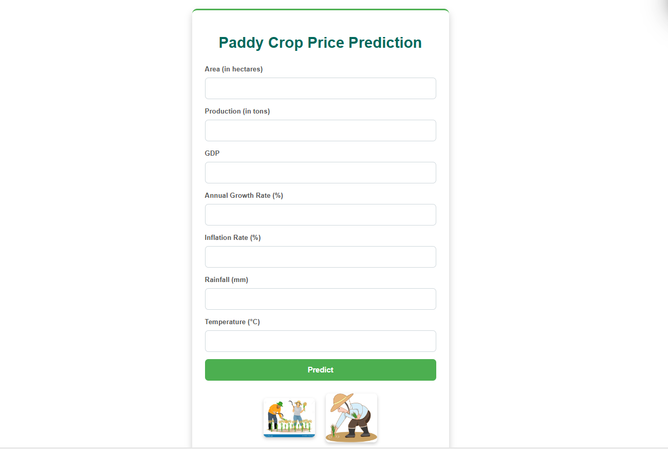

Results

Slide 31
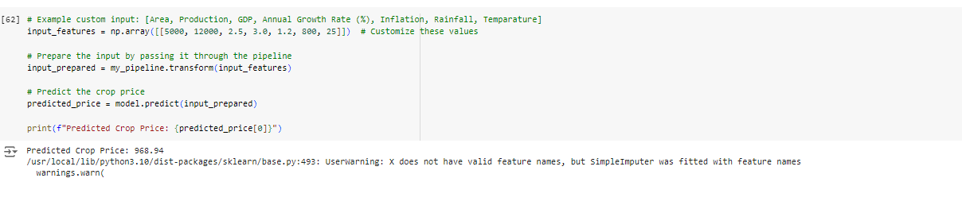
Results
Existing Methods
The dataset contains columns such as Area, Production, GDP, Annual Growth Rate (%), Inflation, Rainfall, Price, and Temperature.
There are 15,104 entries in the dataset, and Temperature has missing values

Slide 32
Results
Proposed Methods
Data Splitting:
The dataset is split into training and test sets using an 80-20 split:
Training set: 12,083 rows
Test set: 3,021 rows
Modeling Approaches:
Various models are mentioned, including:
Linear Regression
Decision Tree Regressor
Random Forest Regressor (selected model)
Support Vector Classifier (not used in the results)
The Random Forest Regressor was chosen and trained on the prepared training data.
Predictions:
Predictions were made using the Random Forest model:
python
Copy code
array([1309., 1110., 1575., 864., 939.])
Model Evaluation:
Root Mean Squared Error (RMSE) is calculated using the training set predictions. The specific RMSE value isn't shown in the extracted cells but is computed as part of the evaluation.

Slide 33
Results
Comparison Results
Random Forest Regressor (Initial Training Evaluation):
RMSE on the training set: RMSE=1.33\text{RMSE} = 1.33RMSE=1.33
Cross-Validation Results (10-Fold):
RMSE scores for each fold in cross-validation: [5.41,3.84,5.17,2.14,3.87,4.55,4.46,3.43,4.56,4.43][5.41, 3.84, 5.17, 2.14, 3.87, 4.55, 4.46, 3.43, 4.56, 4.43][5.41,3.84,5.17,2.14,3.87,4.55,4.46,3.43,4.56,4.43]
Mean RMSE: 4.194.194.19
Standard Deviation of RMSE: 0.890.890.89
These results suggest that the Random Forest Regressor performs reasonably well, with a mean RMSE of around 4.19 across the folds. The relatively low standard deviation indicates that the model is consistent across different data splits.

Slide 34
References
1. Singh, N., & Sindhu, R. (2024). Crop Price Prediction Using Machine Learning. Journal of Electrical Systems, 20(7s), 2258-2269.
2. Dharmayanti, D. I. A. N., Akma, A. O., Soegoto, E. S., & Warlina, L. (2024). APPLICATION OF DATA MINING FOR PREDICTING HORTICULTURAL COMMODITIES PRICE. Journal of Engineering Science and Technology, 19(1), 163-175.
3. Mohanty, M. K., Thakurta, P. K. G., & Kar, S. (2023). Agricultural commodity price prediction model: a machine learning framework. Neural Computing and Applications, 35(20), 15109-15128.
4. Elbasi, E., Zaki, C., Topcu, A. E., Abdelbaki, W., Zreikat, A. I., Cina, E., ... & Saker, L. (2023). Crop prediction model using machine learning algorithms. Applied Sciences, 13(16), 9288.
5. Hirapara, J., & Vanjara, P. (2022, April). A comparative study of data mining techniques for agriculture crop price prediction. In 2022 IEEE 7th International conference for Convergence in Technology (I2CT) (pp. 1-6). IEEE.
6. Soni, N., & Raut, J. (2022). Crop Price Prediction Using Machine Learning Techniques. International Advanced Research Journal in Science, Engineering and Technology (IARJSET). Published in.

Slide 35
References
7. Chen, Z., Goh, H. S., Sin, K. L., Lim, K., Chung, N. K. H., & Liew, X. Y. (2021). Automated agriculture commodity price prediction system with machine learning techniques. arXiv preprint arXiv:2106.12747.
8. Ghutake, I., Verma, R., Chaudhari, R., & Amarsinh, V. (2021). An intelligent crop price prediction using suitable machine learning algorithm. In ITM web of conferences (Vol. 40, p. 03040). EDP Sciences.
9. Dhanapal, R., AjanRaj, A., Balavinayagapragathish, S., & Balaji, J. (2021, May). Crop price prediction using supervised machine learning algorithms. In Journal of Physics: Conference Series (Vol. 1916, No. 1, p. 012042). IOP Publishing.
10.Bayona-Oré, S., Cerna, R., & Tirado Hinojoza, E. (2021). Machine learning for price prediction for agricultural products.
11.Samuel, P., Sahithi, B., Saheli, T., Ramanika, D., & Kumar, N. A. (2020). Crop price prediction system using machine learning algorithms. Quest Journals Journal of Software Engineering and Simulation.
12.Medar, R., Rajpurohit, V. S., & Shweta, S. (2019, March). Crop yield prediction using machine learning techniques. In 2019 IEEE 5th international conference for convergence in technology (I2CT) (pp. 1-5). IEEE.

Slide 36


